Slide 1

Vel Tech Rangarajan Dr. Sagunthala R&D Institute of Science and Technology
School of Computing
Department of Computer Science and Engineering
10211CS224 / FULL STACK APPLICATION DEVELOPMENT (JAVA)
END SEMESTERPROJECT REVIEW
Date: 06-05-2026
JOB PORTAL MANAGEMENT SYSTEM
SDG: SDG No – 9: Industry, Innovation, and Infrastructure
Presented By:
K SAI MANIKANTA – VTU25937 – 23UECS0639
Courses Handling Faculty:
Dr.Hemamalini-Assistant Professor

Slide 2
INTRODUCTION
Background of the problem
Traditional job searching and recruitment processes are often manual, time-consuming, and inefficient. There is a need for a centralized digital platform to connect job seekers and employers.
Why this project is important
This system simplifies the hiring process by providing an organized platform for job posting and applications. It reduces effort, saves time, and improves accessibility for both recruiters and candidates.
Real-world relevance
Job portals are widely used in today’s digital world for recruitment across industries. This system reflects real-world platforms like LinkedIn and Indeed.
Brief overview of the system
The Job Portal Management System allows employers to post jobs and candidates to search and apply online. It manages user profiles, job listings, and application tracking in an efficient and user-friendly way.
1
2
3
4
5
6
7
8
9

Slide 3
PROBLEM STATEMENT
In today’s digital era, job seekers often face difficulty in finding suitable job opportunities due to scattered information across multiple platforms, making the process confusing and time-consuming. Employers also encounter challenges in managing job postings and selecting the right candidates efficiently using traditional or manual methods. The lack of a centralized system creates a gap between job providers and applicants, leading to missed opportunities and delays in recruitment. Many existing platforms are either complex, not user-friendly, or do not provide complete functionality for both users. This results in inefficient communication and poor management of applications. Job seekers may miss relevant openings, while employers may fail to reach qualified candidates. There is a growing need for a system that simplifies and organizes the recruitment process. A unified platform can reduce effort and improve accessibility for all users.
1
2
3
4
5
6
7
8
9

Slide 4
OBJECTIVE(S)
To develop a centralized platform that connects job seekers and employer
This system reduces the gap between candidates and recruiters.
Users can find jobs based on their skills and preferences.
To allow employers to post job vacancies and manage applications.
Recruiters can easily filter and select candidates
.
To provide a user-friendly interface for all users.
The system is designed for easy navigation and accessibility.
1
2
3
4
5
6
7
8
9

Slide 5
PROPOSED SYSTEM
Solution Description & Advantages
1
The system provides a centralized online platform where job seekers and employers
can interact efficiently.
It enables job seekers to search and apply for jobs reducing dependency on multiple sources.
Employers can post job vacancies and manage applications in an organized.
The system solves the issue of scattered job information by bringing all opportunities into
one platform.
It reduces manual effort and paperwork involved in traditional recruitment methods.
The platform improves communication between candidates and recruiters through timely.
Compared to existing systems, it offers a simple and user-friendly interface for better usability.
2
3
4
5
6
7
8
9

Slide 6
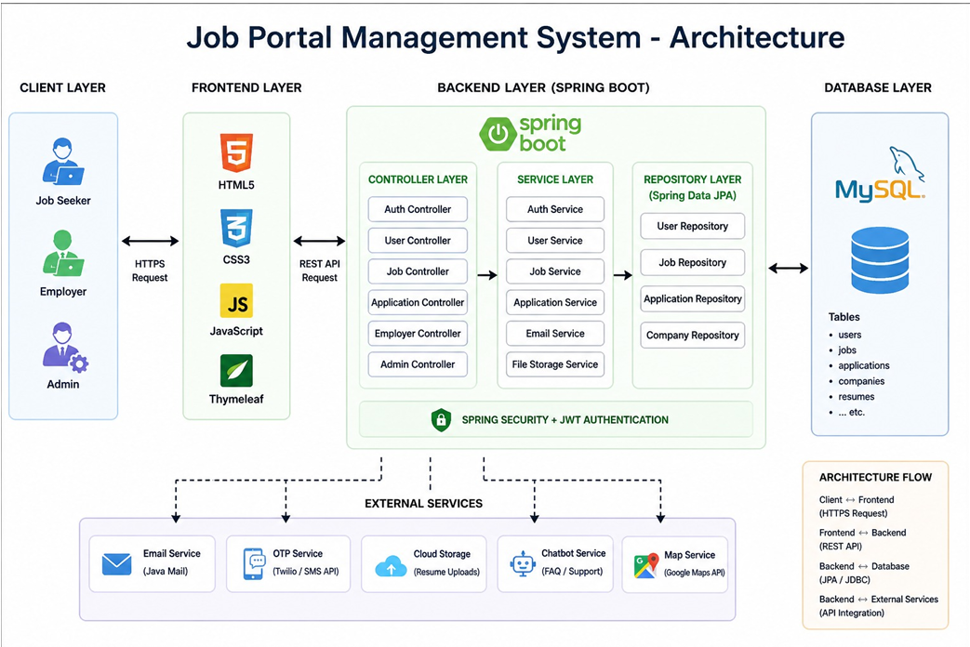
PROPOSED SYSTEM ARCHITECTURE
Input:User data such as job details, applications, and login information entered by job seekers, employers, and admin.
Processing:The system processes requests through frontend and backend logic, including validation, authentication, and job matching.
Database:All data is stored in a MySQL database including users, jobs, applications, companies, and resumes.
Output:The system displays job listings, application status, and results to users through a user-friendly interface.
1
2
3
4
5
6
7
8
9

Slide 7
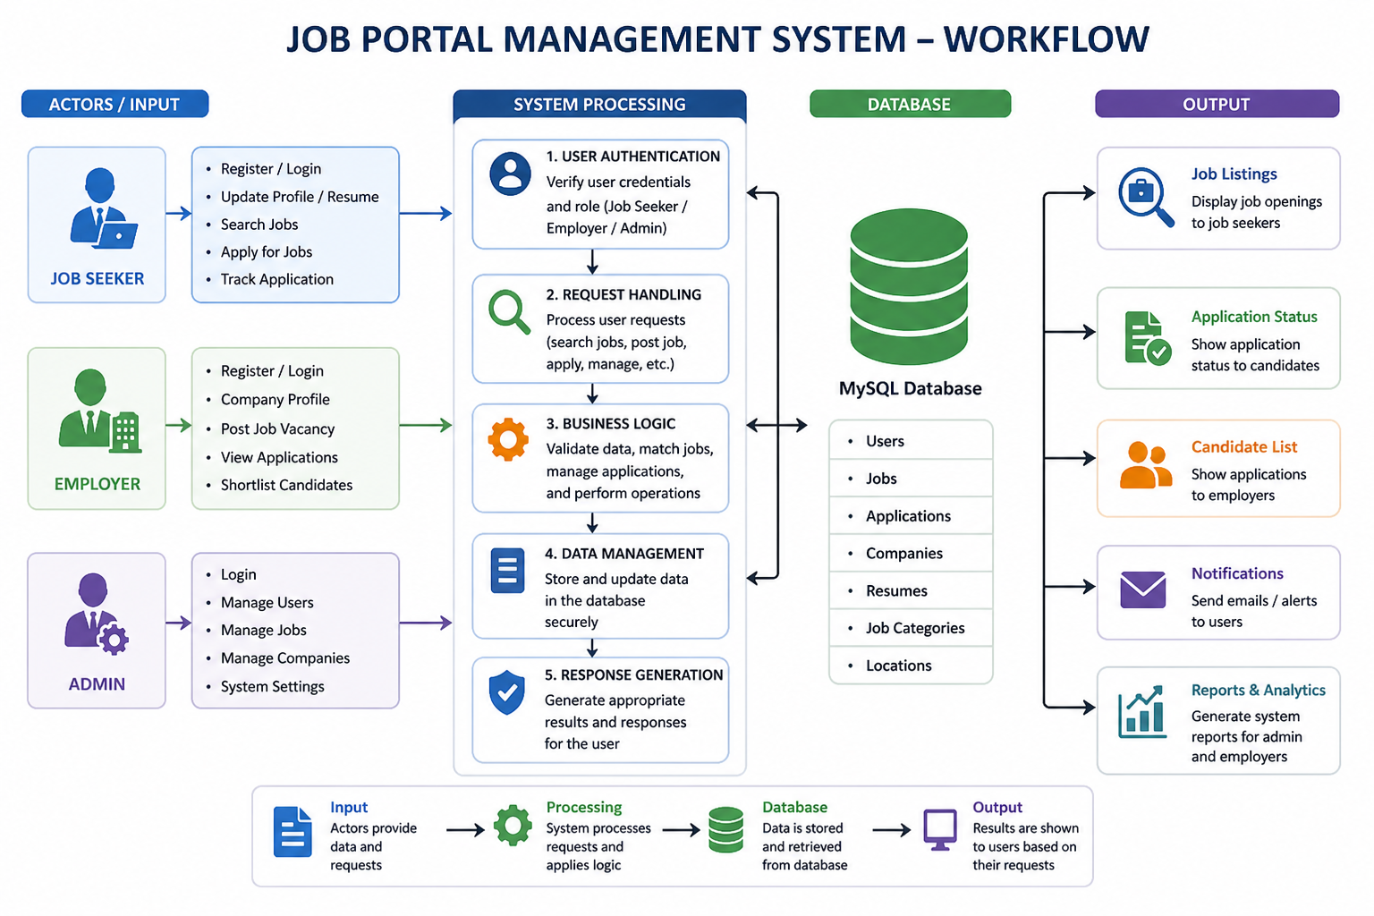
WORKFLOW
1
2
3
4
5
6
7
8
9

Slide 8
TECHNOLOGIES USED
Frontend:
The frontend is developed using HTML5, CSS3, and JavaScript to create an interactive and user- friendly interface.Thymeleaf is used as a template engine to integrate frontend with backend.
Backend:
The backend is built using Spring Boot, which handles business logic and application processing. It includes controller, service, and repository layers for efficient system management.
Database:
MySQL is used as the database to store and manage data such as users, jobs, applications, and companies.It ensures secure, structured, and efficient data storage and retrieval.
Third-Party API:
External APIs such as Email Service (Java Mail), OTP Service (Twilio), and Google Maps API are integrated.These APIs enhance functionality like notifications, verification, and location services
Tools:
Tools like Visual Studio Code / IntelliJ IDEA are used for development, and Git is used for version control.
Hardware/Software Requirements:
The system requires a computer with minimum 4GB RAM and a stable internet connection. Software requirements include Java, MySQL Server, a web browser, and an IDE for development.
1
2
3
4
5
6
7
8
9

Slide 9
MODULE DESCRIPTION
Module 1: User Management
Handles registration and login for job seekers, employers, and admin with secure authentication. Manages user profiles, resumes, and account details efficiently.
Module 2: Job & Application Management
Allows employers to post job vacancies and manage job listings. Enables job seekers to search, apply, and track application status.
Module 3: Backend Processing
Implements business logic using Spring Boot to handle requests and system operations. Processes data validation, job matching, and application workflows.
Module 4: Database Management
Stores and manages data such as users, jobs, applications, and companies in MySQL. Ensures secure storage, quick retrieval, and data integrity.
Module 6: Reporting & Admin Control
Allows admin to manage users, jobs, and system settings. Generates reports and analytics for better monitoring and decision-making.
1
2
3
4
5
6
7
8
9

Slide 10
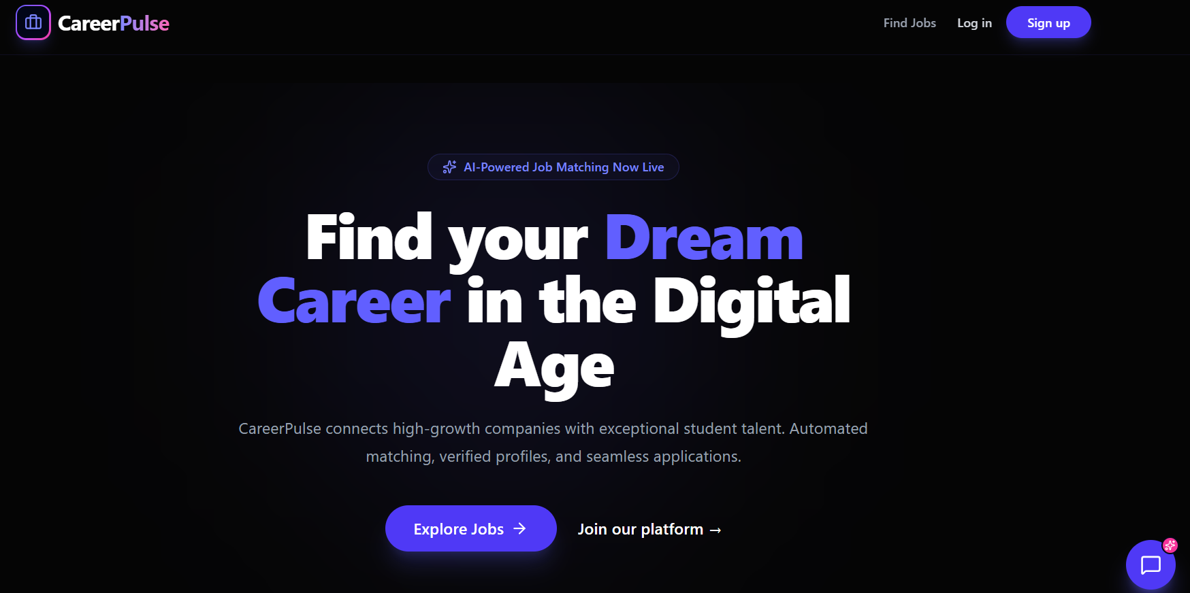
IMPLEMENTATION SCREENSHOTS
Figure shows the homepage of the job portal management system. This page acts as the main dashboard of the application, where users can view placement ex periences shared by other students. Each post contains important details such as company name, job role, interview status, and experience summary.
1
2
3
4
5
6
7
8
9

Slide 11
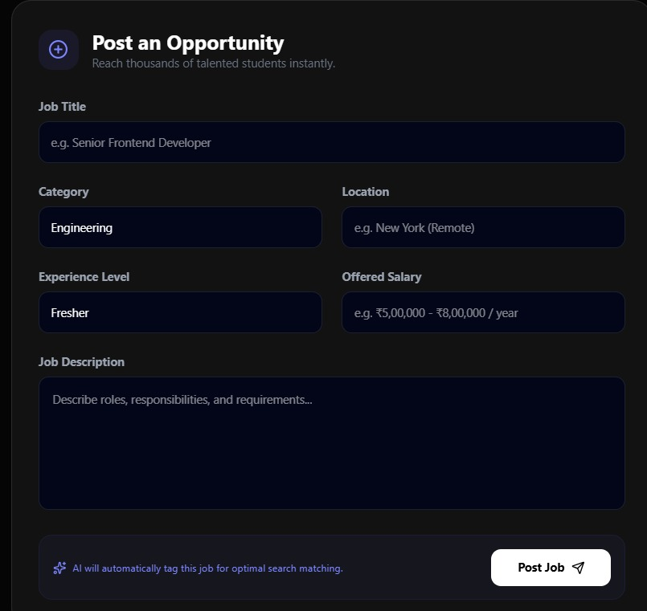
IMPLEMENTATION SCREENSHOTS
Figure shows the post details page of the job portal management system. This page displays complete information about a placement experience shared by a user, including the company name, job role, interview rounds, and overall experience sum mary.
1
2
3
4
5
6
7
8(A)
9

Slide 12
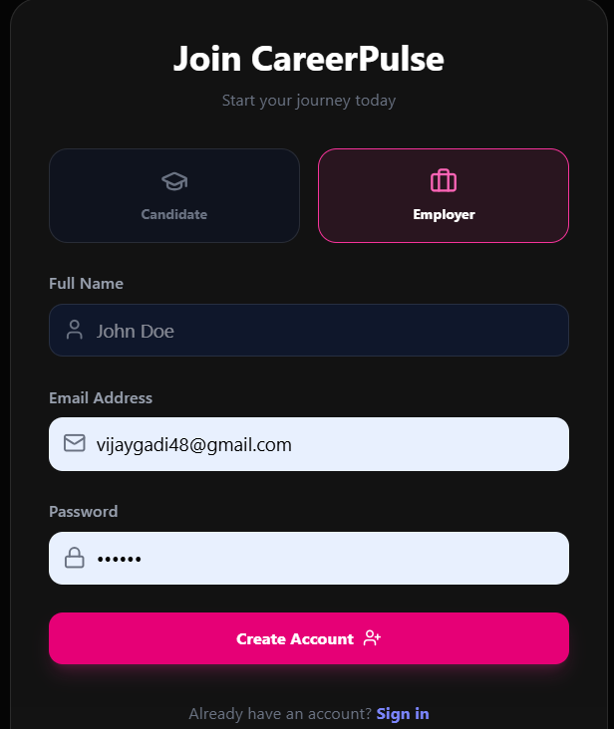
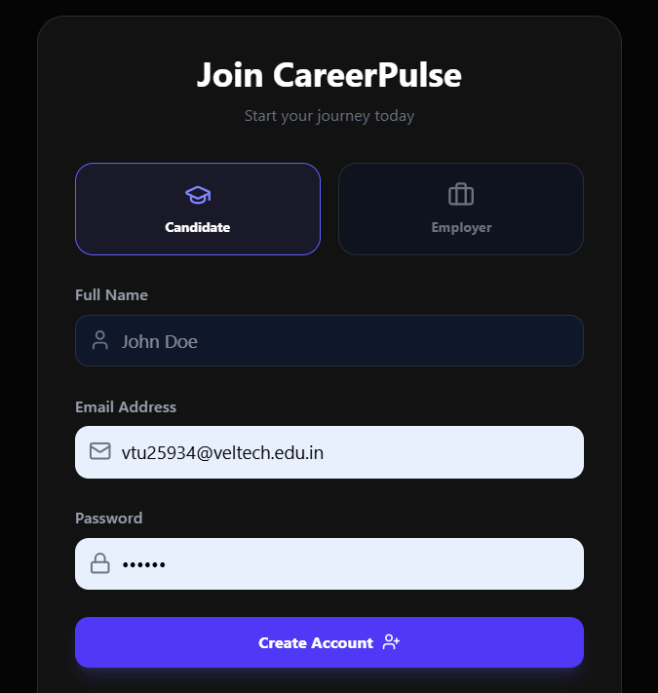
IMPLEMENTATION SCREENSHOTS
Employee sign in page
Candidate sign in page
1
2
3
4
5
6
7
8(B)
9

Slide 13
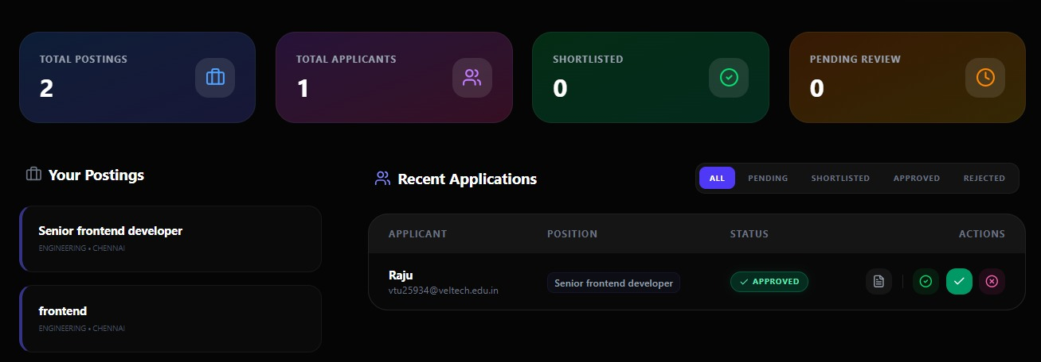
IMPLEMENTATION SCREENSHOTS
Figure shows the posting page of the system. This page allows authenticated users to share their placement experiences by entering details such as company name, job role, placement type, interview year, and round-wise experiences. Users can add technical questions, coding challenges, and preparation tips based on their interview journey.
1
2
3
4
5
6
7
8(C)
9

Slide 14
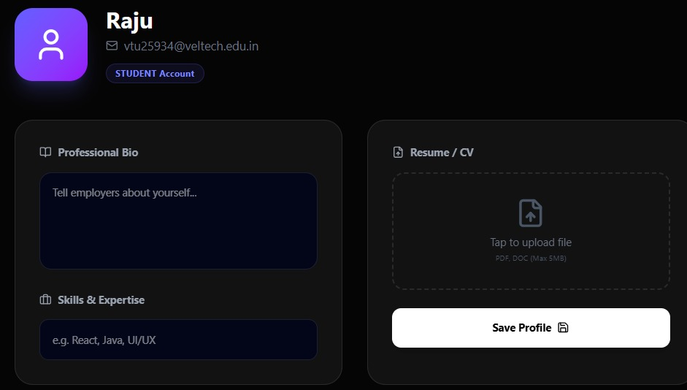
IMPLEMENTATION SCREENSHOTS
Figure 5.5 shows the user profile page of the job portal management system. This page displays user information such as profile details, shared placement experiences, and user activity within the platform. It allows users to manage their personal in formation and view their contributions.
1
2
3
4
5
6
7
8(C)
9

Slide 15
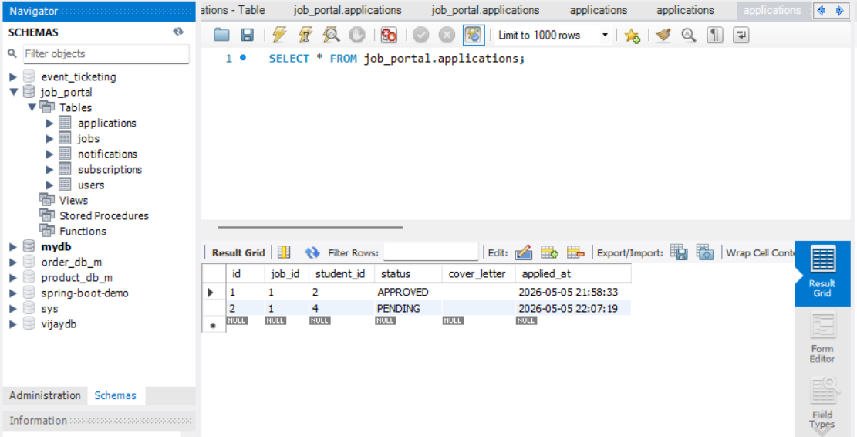
IMPLEMENTATION SCREENSHOTS
The image shows the applications table in the MySQL database of the Job Portal Management System. It displays job application details such as job ID, student ID, status, and application time.
1
2
3
4
5
6
7
8(C)
9

Slide 16
ADVANTAGES & LIMITATIONS
Advantages
Provides a centralized platform for job seekers and employers.
Reduces time and effort in the recruitment process.
Easy to search, apply, and manage job applications online.
Improves communication between candidates and recruiters.
User-friendly interface for better accessibility.
Secure data management using database systems
Limitations
Requires internet connection to access the system.
Initial setup and maintenance can be complex.
Data security risks if not properly managed.
Depends on system performance and server availability.
Limited features compared to large commercial platforms.
May require regular updates and technical support.
1
2
3
4
5
6
7
8
9

Slide 17
Thank you

